Slide 1



Discuss in pairs
Are these a good idea?
Notes:
https://www.youtube.com/watch?v=9gyO0ZOXQU4&list=PLCiOXwirraUDRk5TlB2ulS3V2-0tB3vcS&index=6

Slide 2
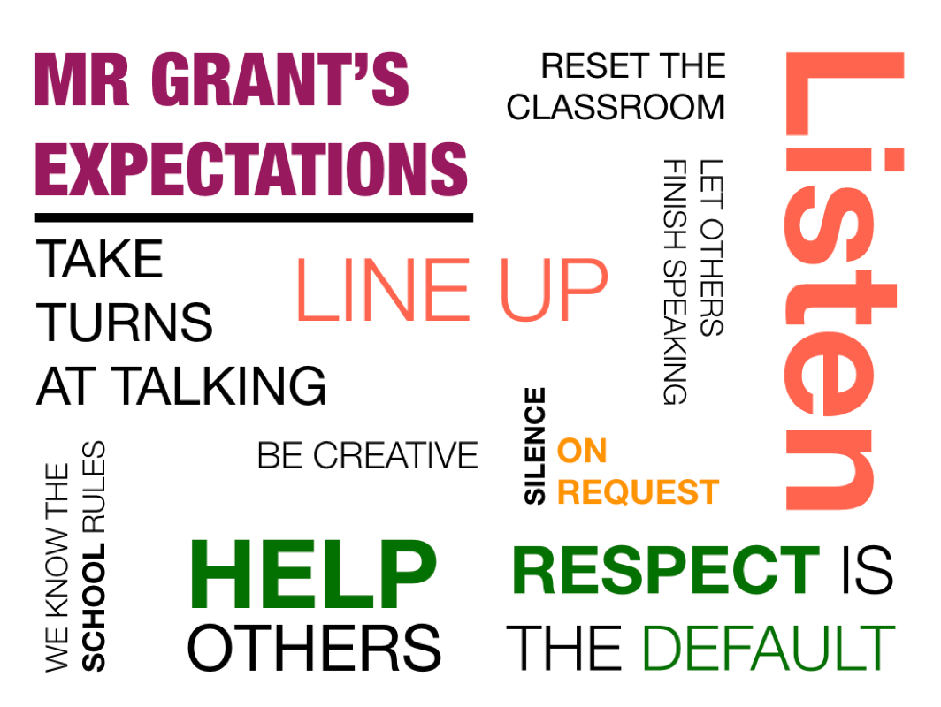
Expectations
COMPLETING HOMEWORK WILL PREPARE YOU FOR CLASS

Slide 3
Preventing Vulnerabilities
Year 8
Managing risks and security in Computing

Slide 4
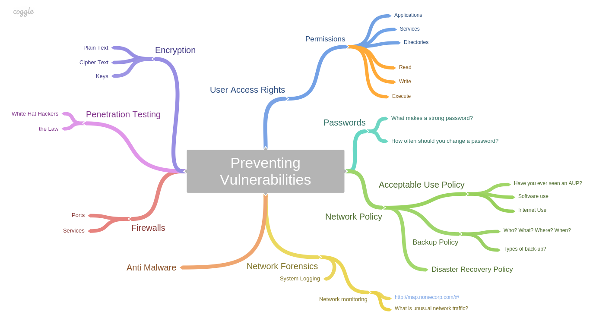
Subject roadmap

Slide 5
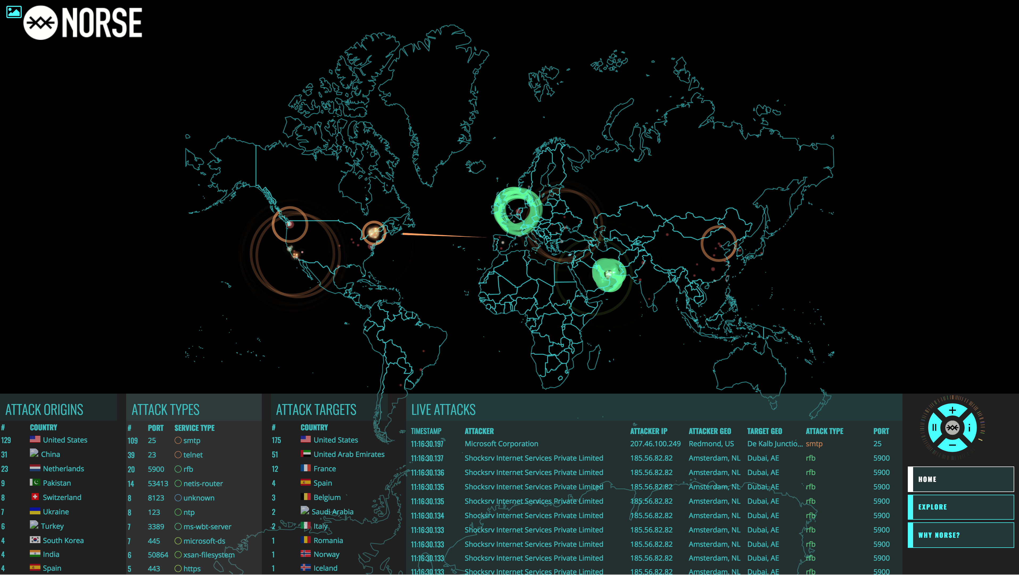
Network monitoring

Slide 6
Activity
20 Preventing Vulnerabilities
Complete worksheet 20 and research the topics using the website provided
Location: On the Year 8 shared drive
Notes:
Highlight

Slide 7
Homework
Complete task .
Write it in your diaries.
Location on Google Classroom
Notes:
How was that? Any questions? How do you feel?

Slide 8
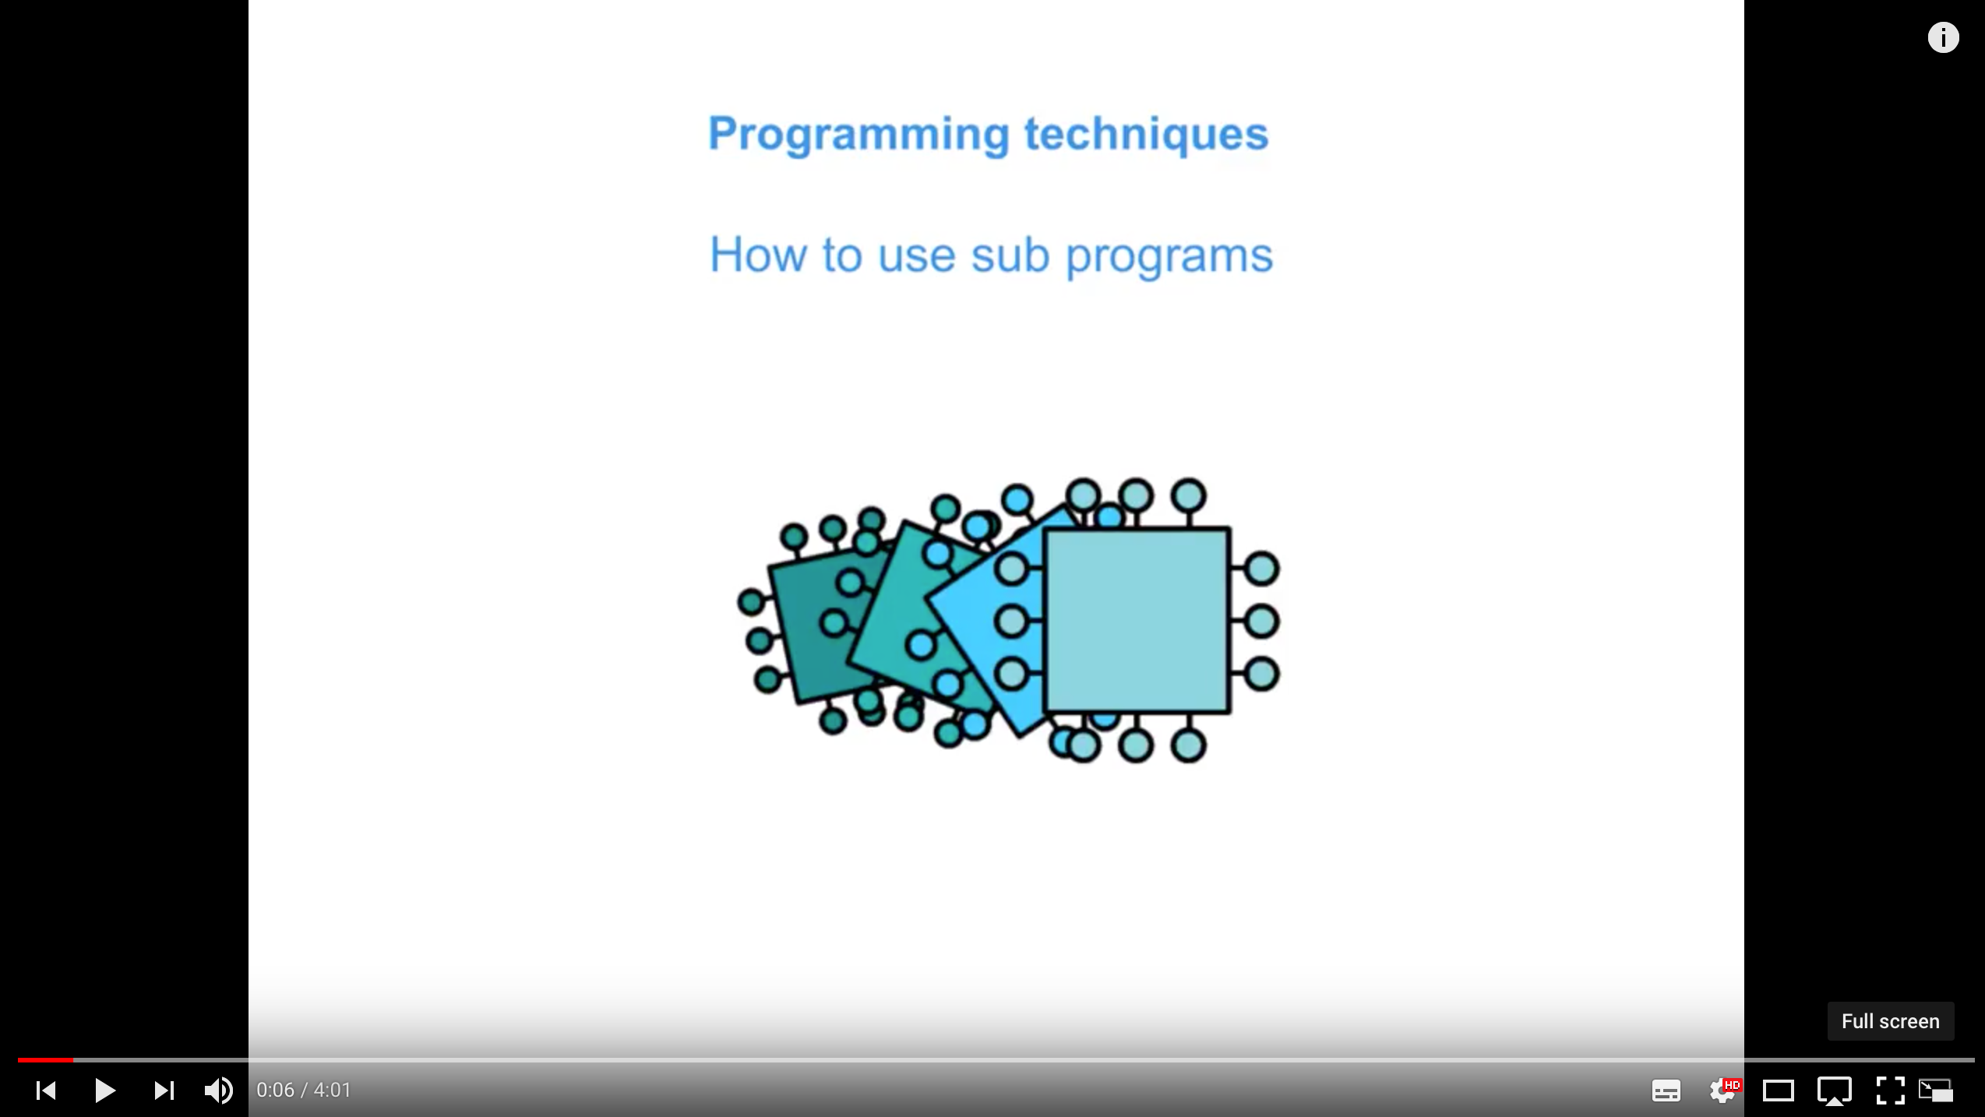
Plenary
Plenary
We have seen how to:
use data types: integer, real, Boolean, character and strings
declare and use constants and variables
use input, output and assignment statements
use arithmetic operators including MOD and DIV
use string methods and conversion functions
Notes:
How was that? Any questions? How do you feel?

